Slide 1
307 Group Project
Team Conveyor Presents
Chuan Yang
Mengyang Chen
Su Dong
Yiting Dong

Slide 2
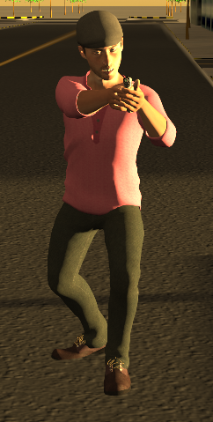
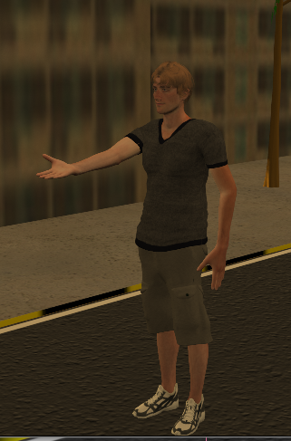
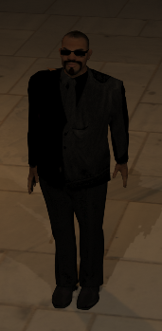
Storyline
Some day, FBI finds a location of the terrorists and prepare to arrest them. However, the terrorists anti-detected FBI and gave them a “surprise”. After the failure of FBI, our hero appears.
FBI BOSS Hero Terrorist

Slide 3
Scenes
FBI Office Chuan
Terrorists’ place
Stairs and Corridor Mengyang
City Yiting
Award Su
Car motion (Motion path) Yiting
Character Actions Armed force: Mengyang
(Curve Editor) Terrorist and the hero: Chuan
Motion

Slide 4
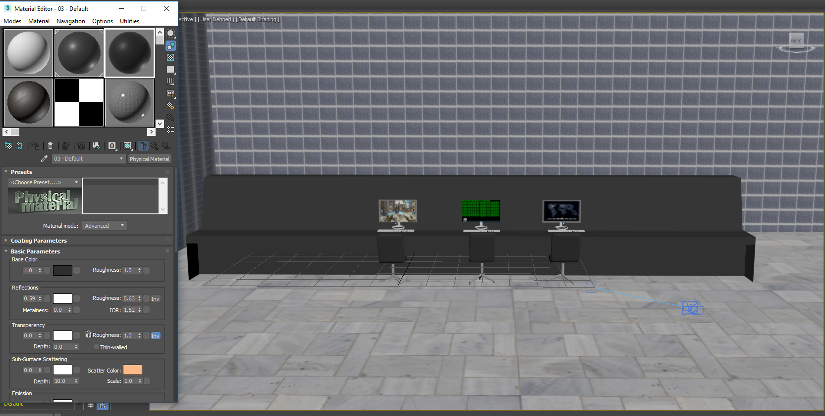
FBI Office
Models:
office chairs
table
wall and floor
Light:
All free light

Slide 5
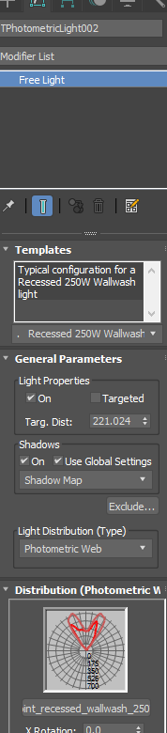
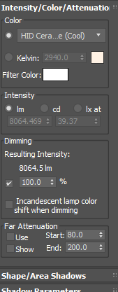
FBI Office
Light:
Use default template in this scene
Changed color and the strength of light

Slide 6
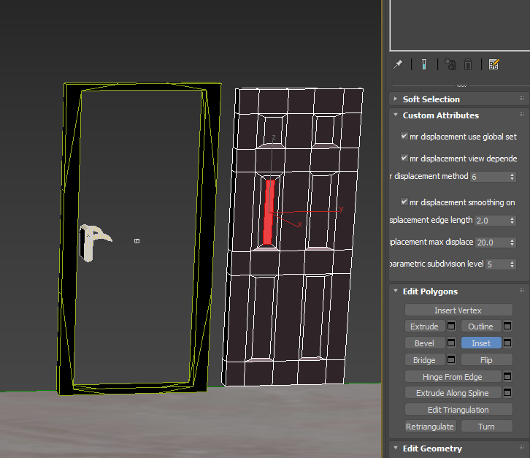
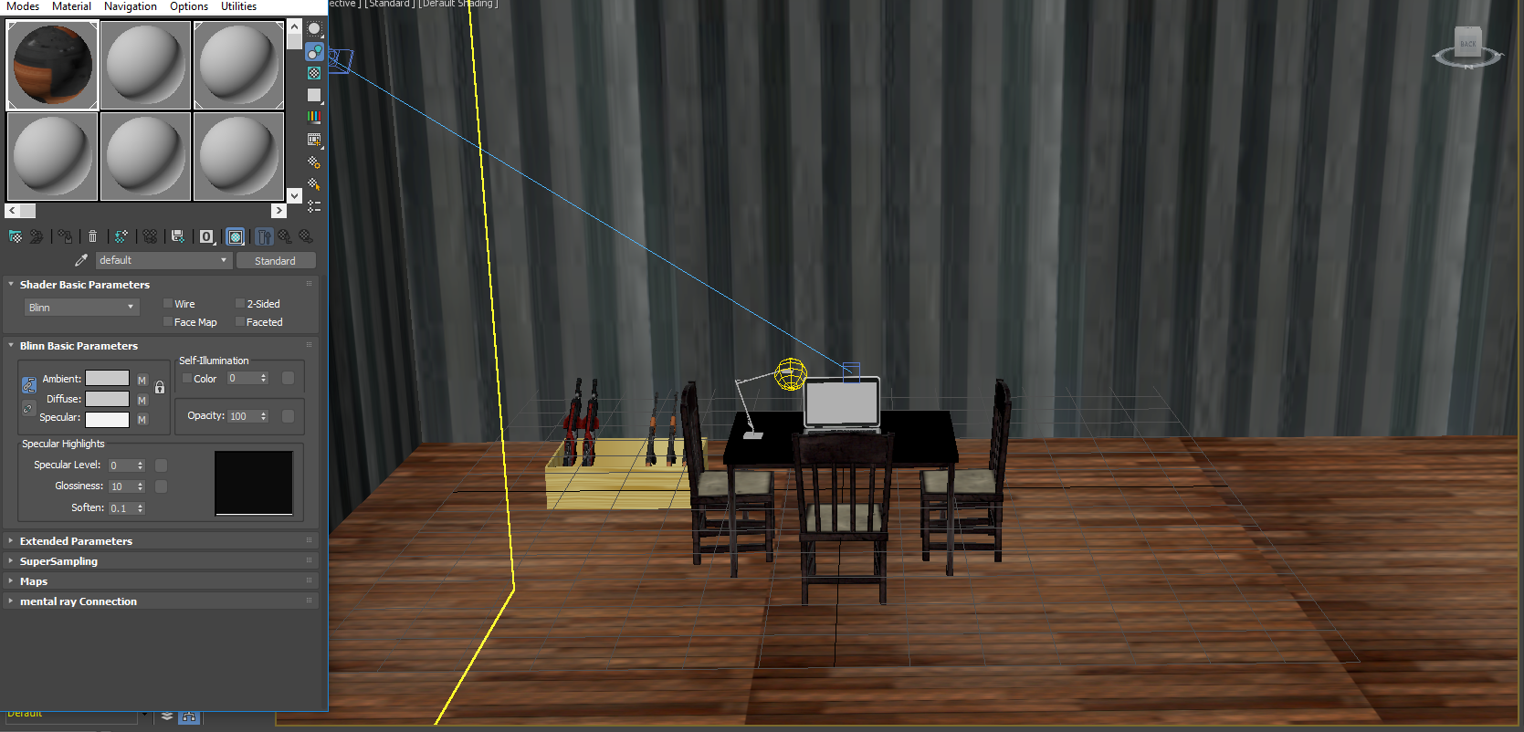
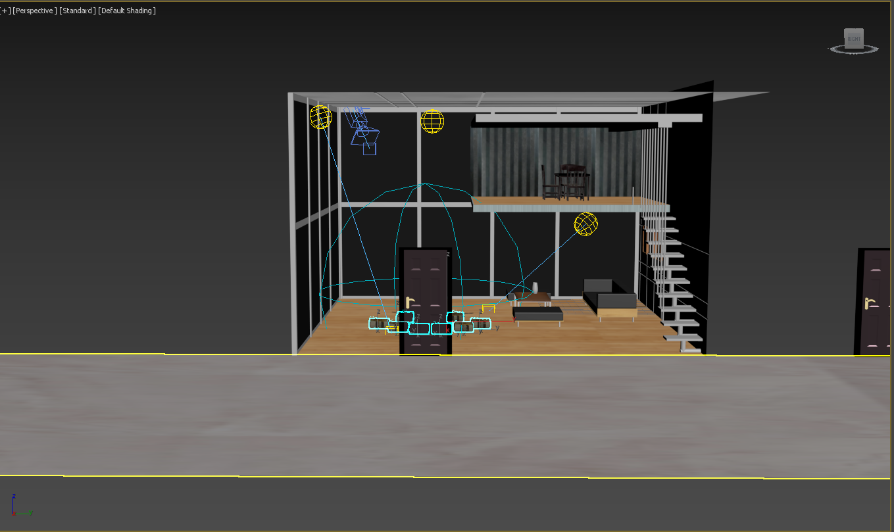
Terrorists’ Place
Models:
Most from online source
Door
Light:
Free light:
Default
Recessed Wallwash

Slide 7
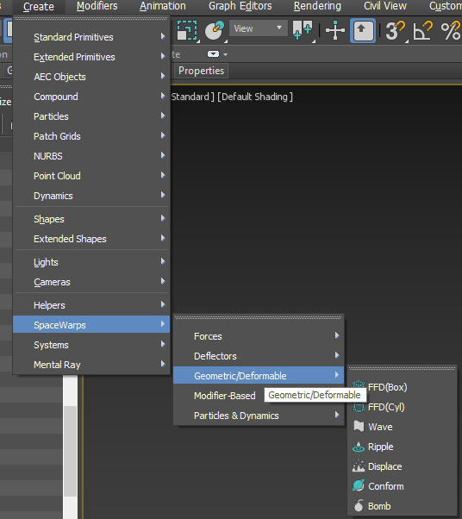
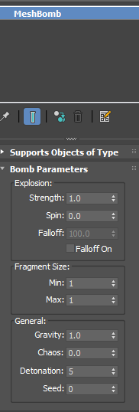
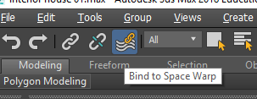
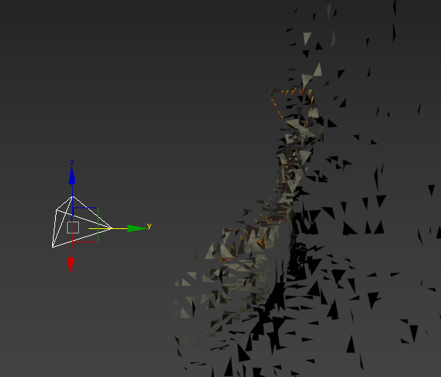
Terrorists’ Place
Bomb Effect:
Bomb: Create by Meshbomb
in 3ds max
Bind to the object

Slide 8
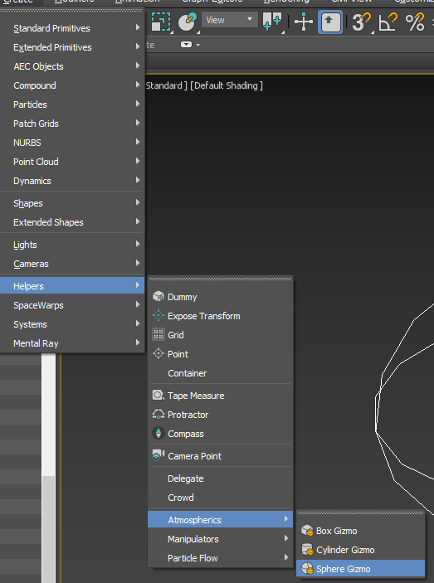
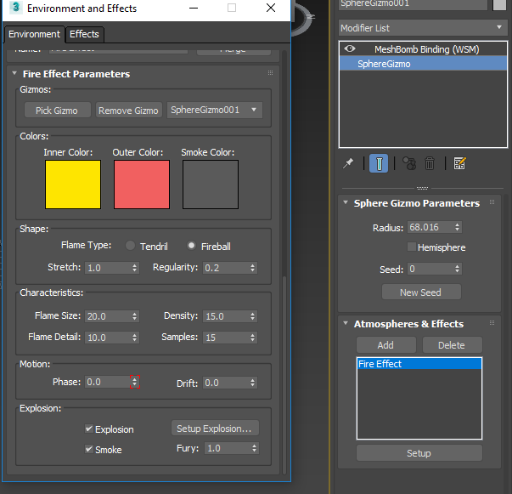
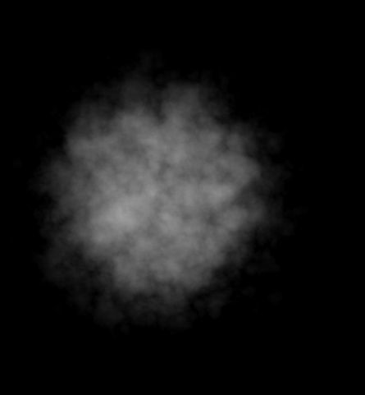
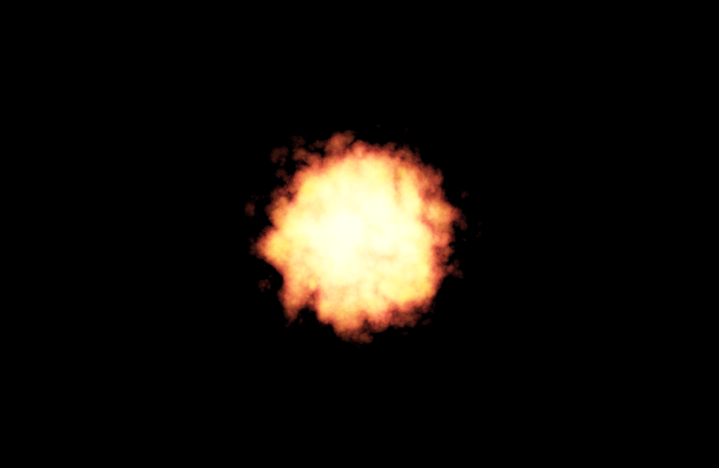
Terrorists’ Place
Bomb Effect:
Fire effect: Create by
Sphere Gizmo
Check the explosion in
settings

Slide 9
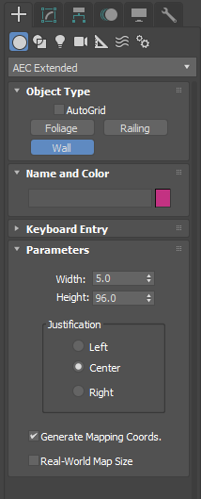
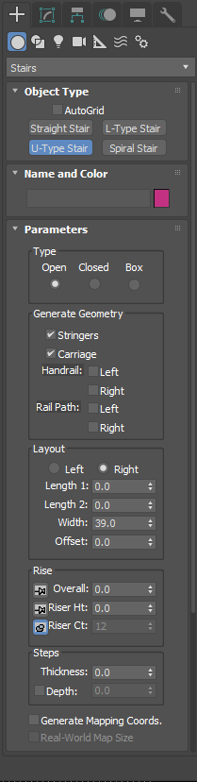
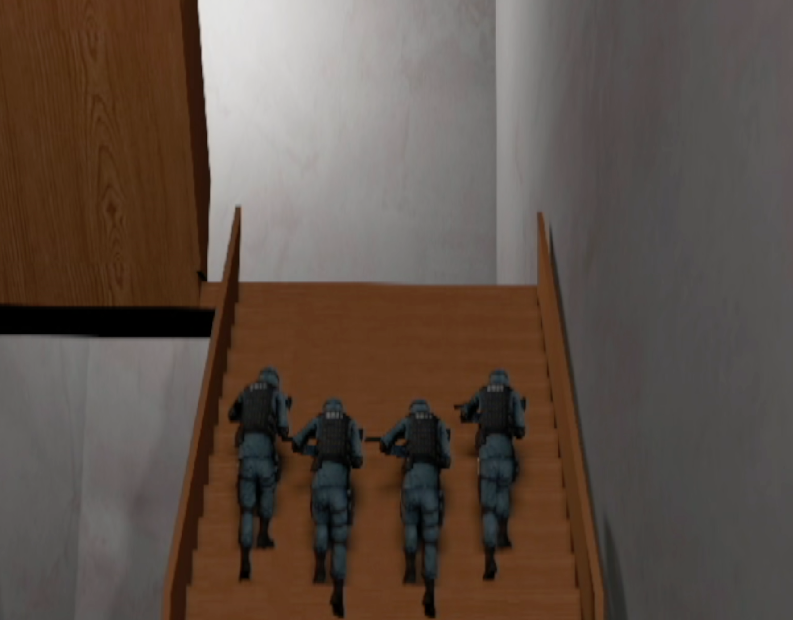
Stair scene:
Wall:
AEC Extended(Wall)
Stairs:
Stairs(U-Type Stair)
Floor:
Plane
Light:
Recessed 250w wall wash

Slide 10
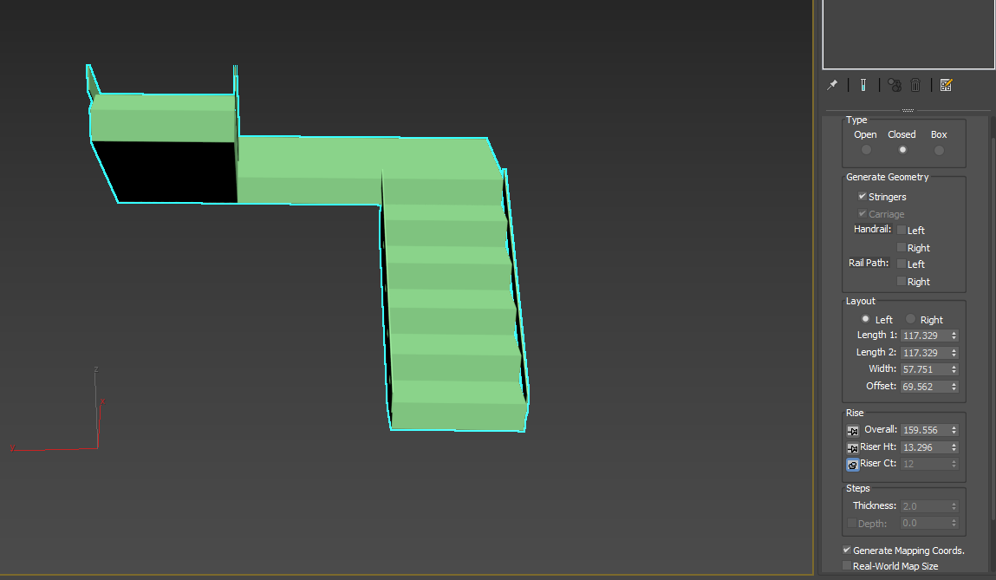

Slide 11
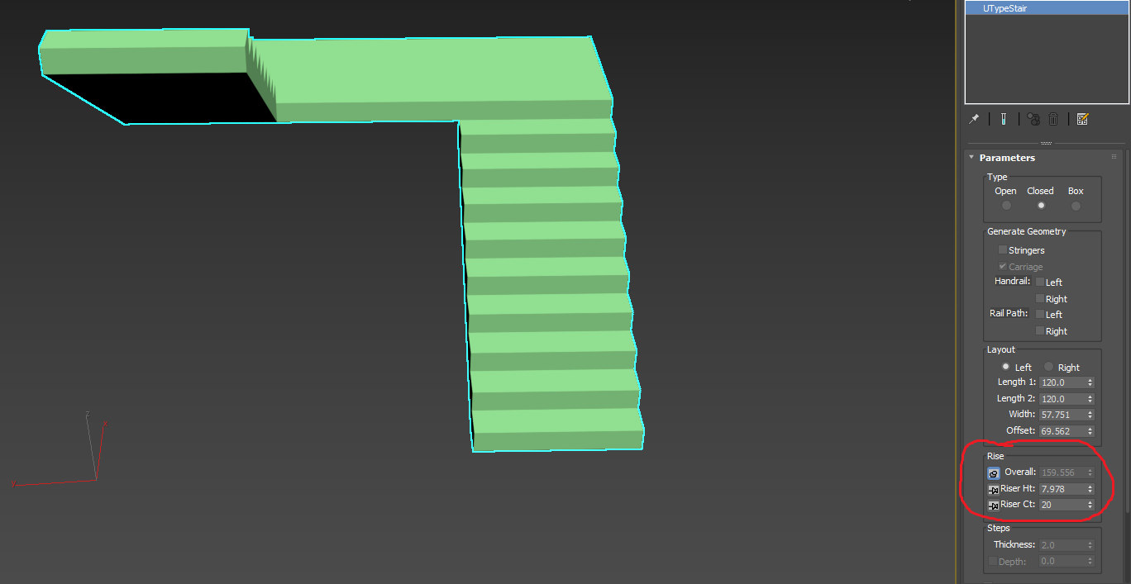
City
Models: Buildings, Roads, Cars, Trees
Lights: Daylights,

Slide 12
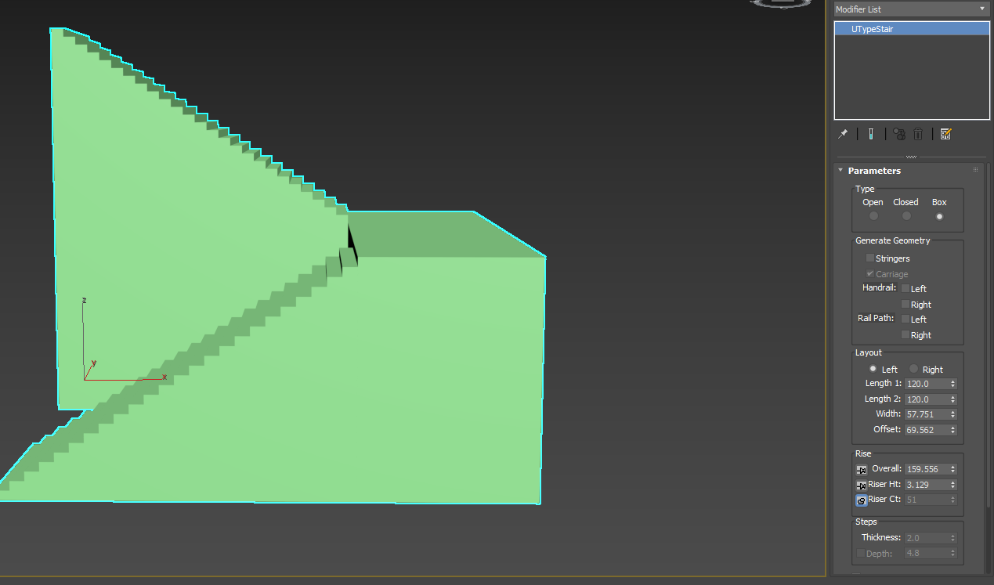

Slide 13
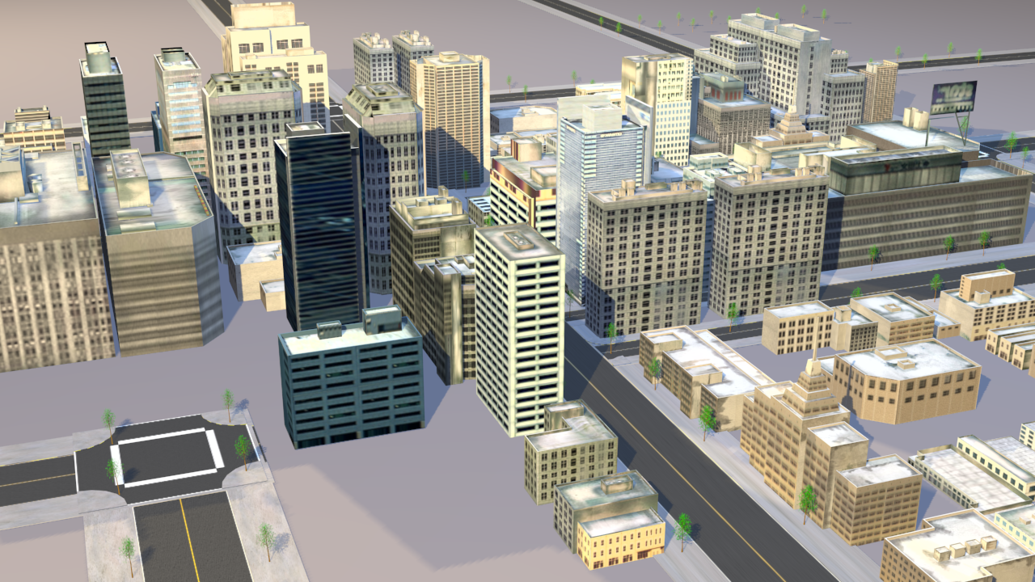
City
Models:
Buildings, Roads, Trees
Lights:
Day lights and Sunset lights

Slide 14
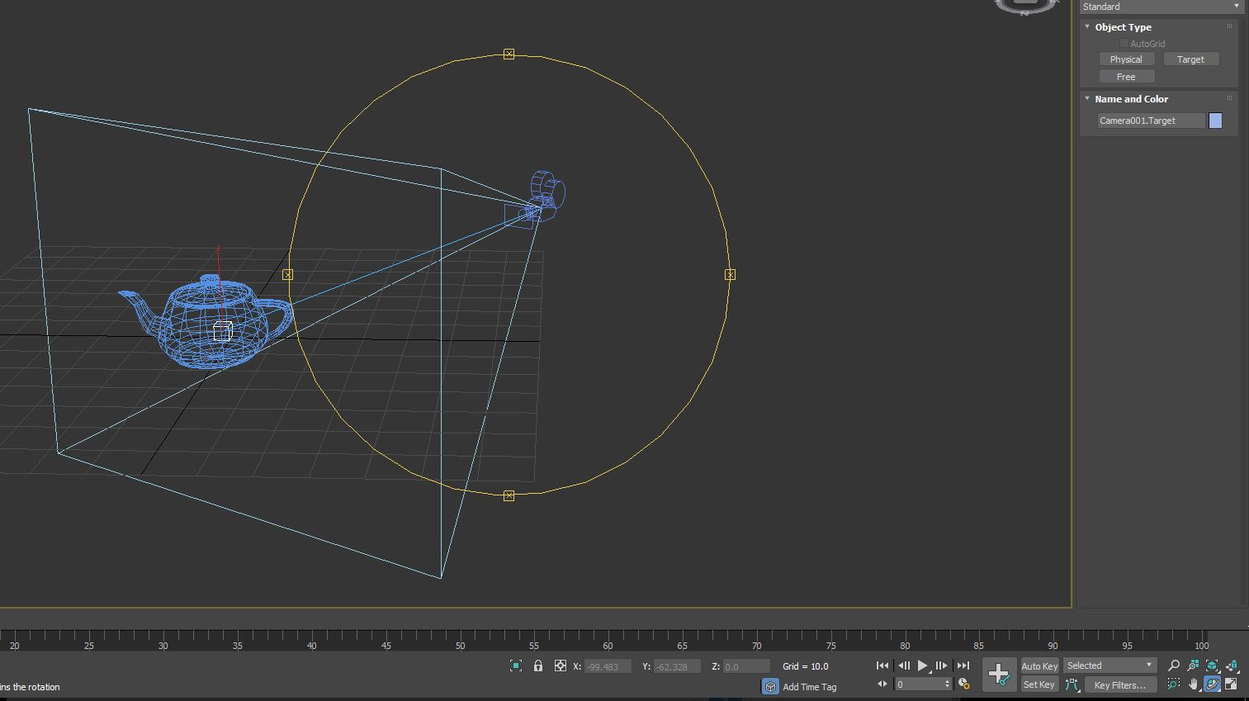
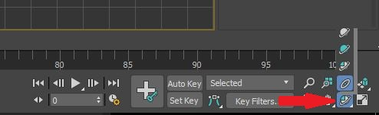
City
Rotate Camera

Slide 15
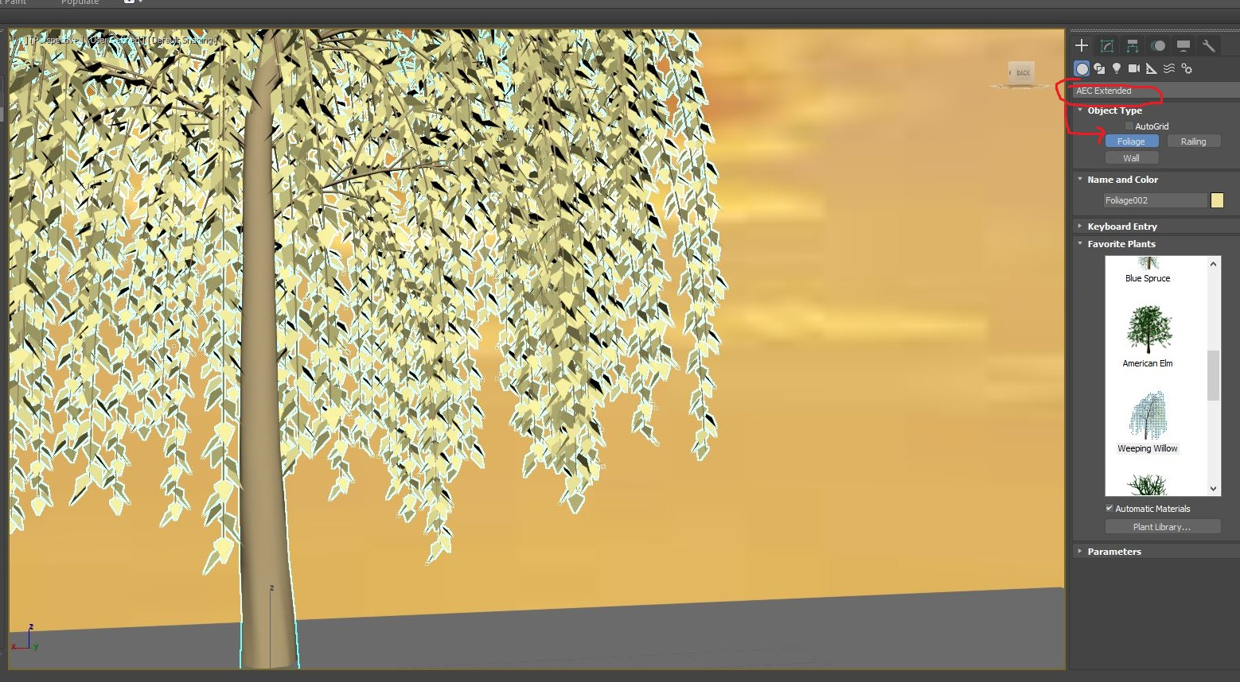
City
Trees:

Slide 16
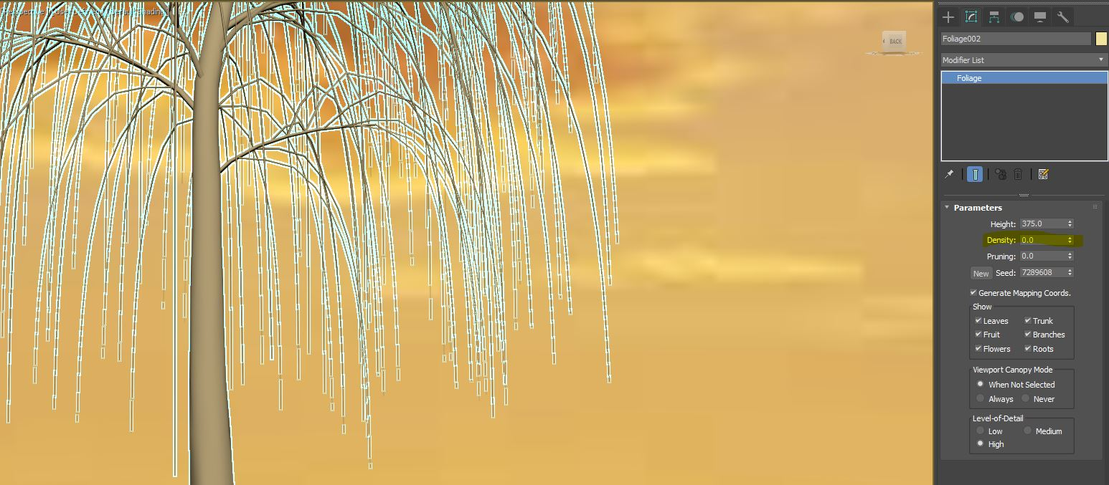
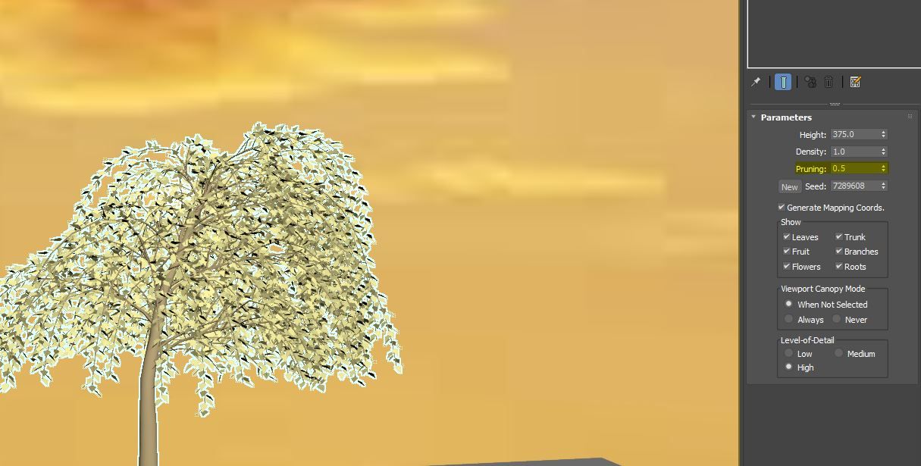
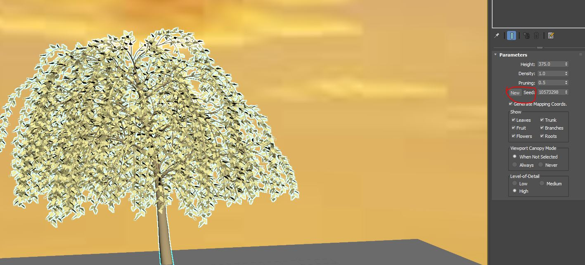
City
Tree Parameters:
Density, Pruning, Seed

Slide 17
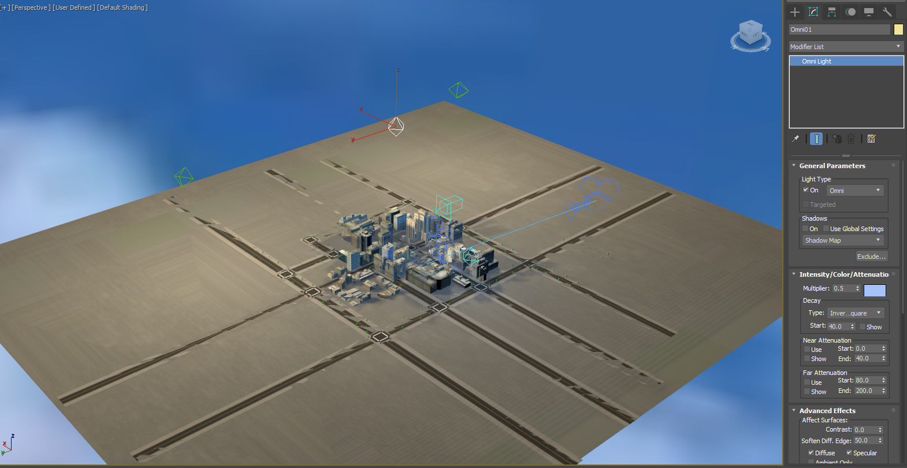
City
Daylights:
Omni Light

Slide 18
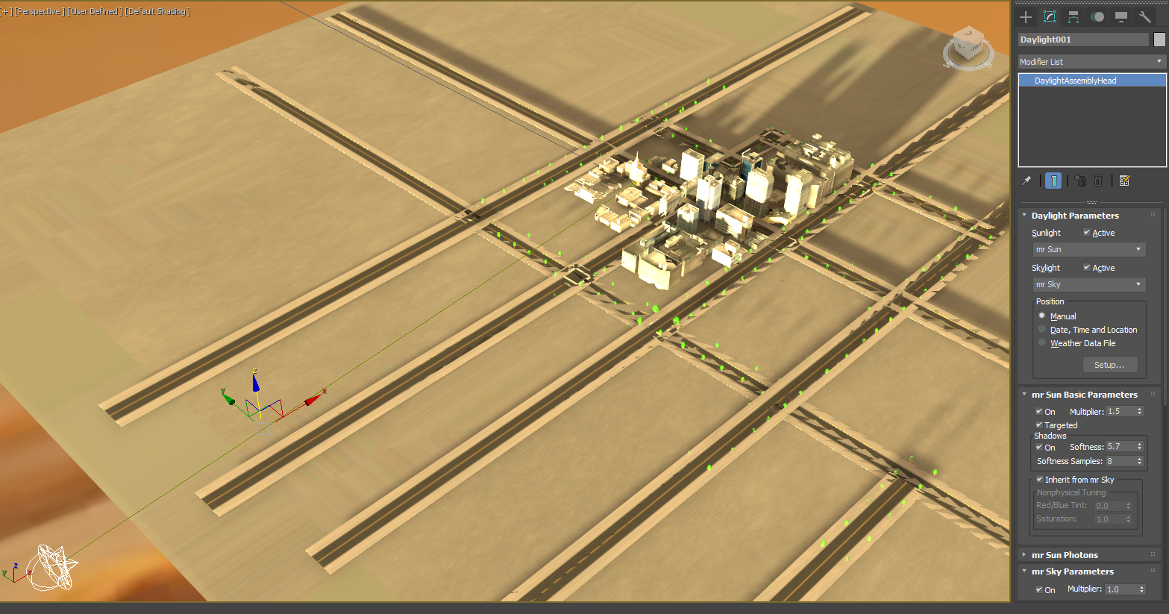
City
Sunset Light:
Environment
with Daylight

Slide 19
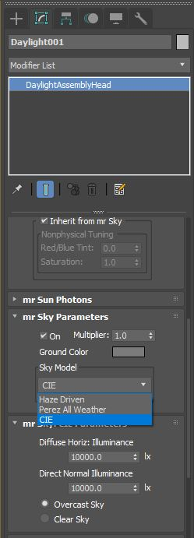
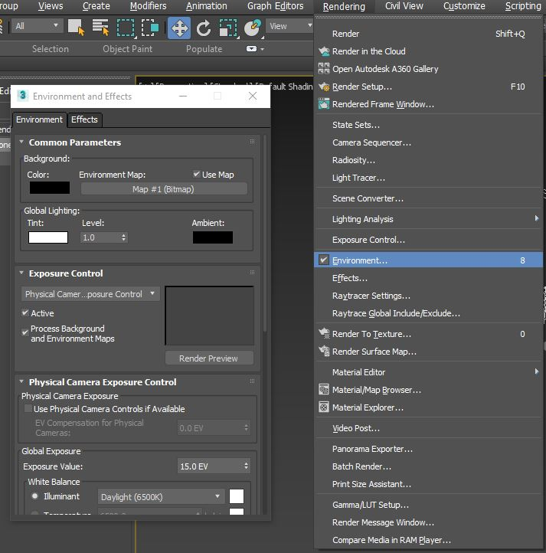
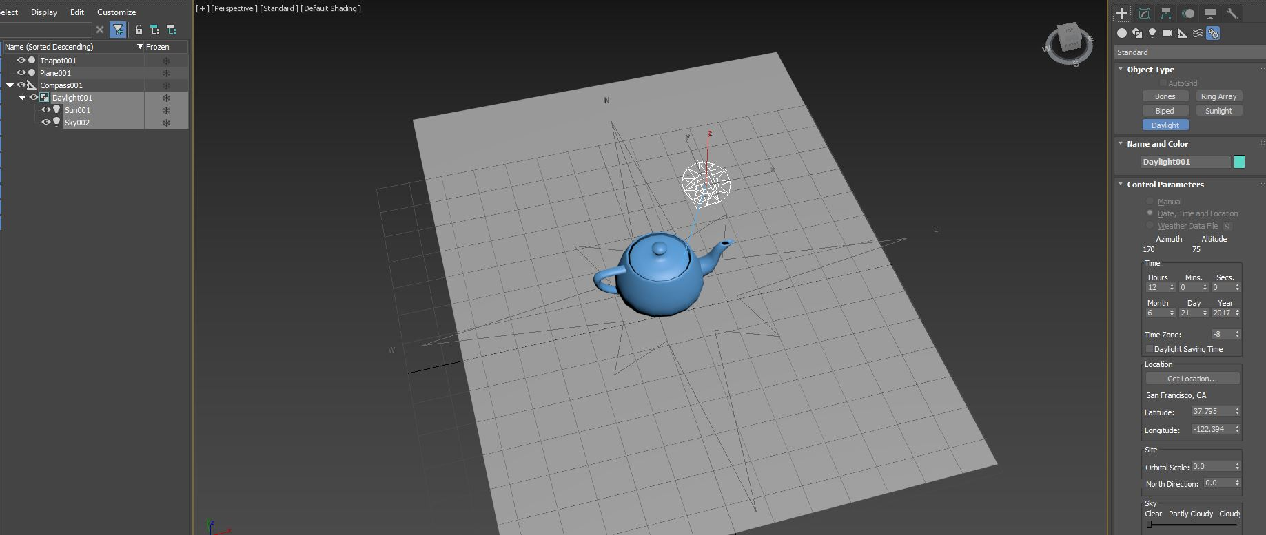
City
How to create a sunset light?

Slide 20
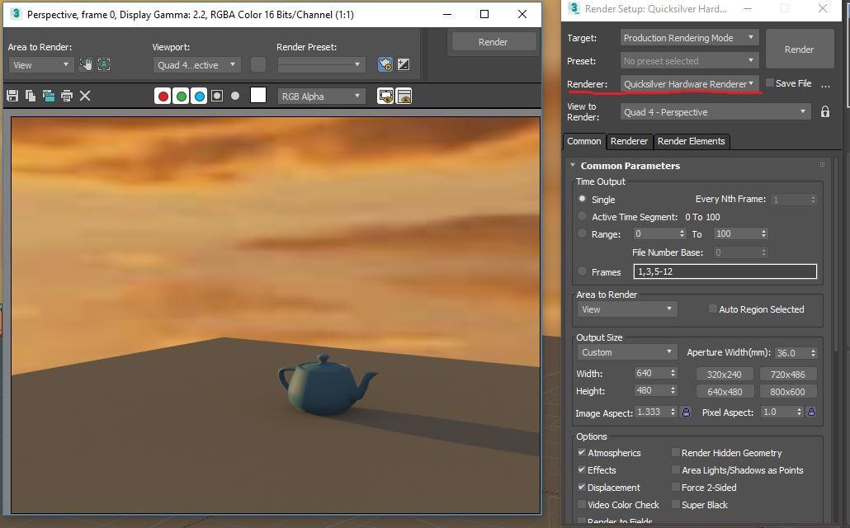
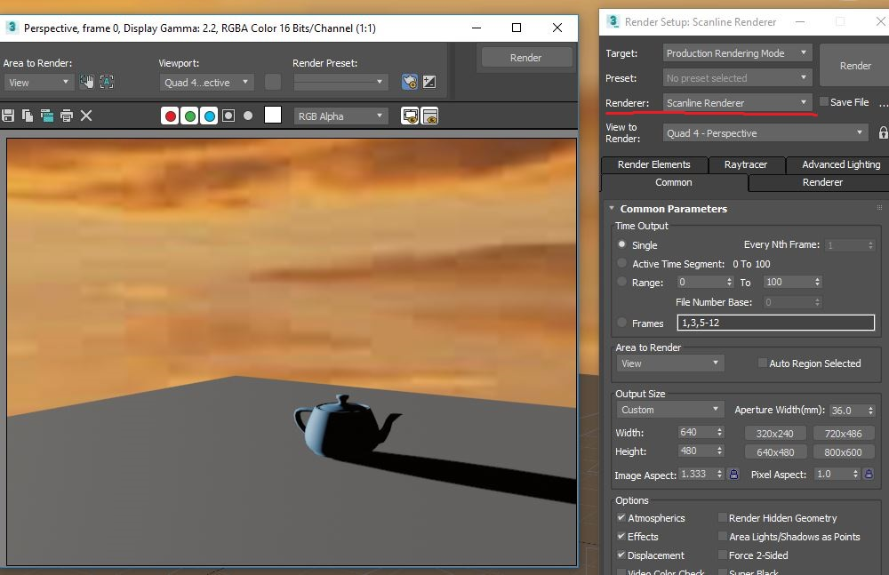
City

Slide 21
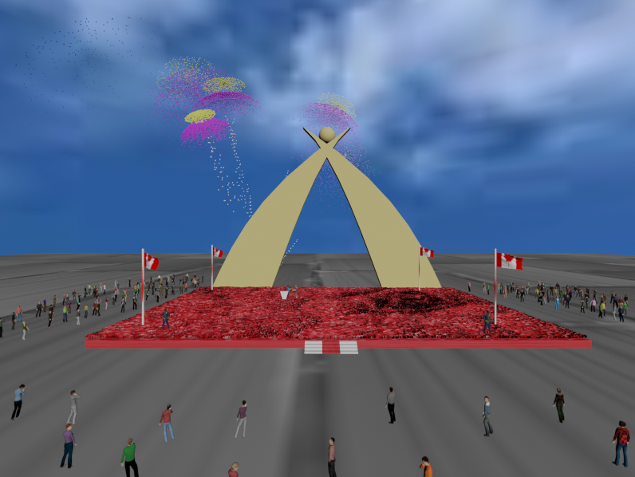
Award
Models:
Firework
Red Carpet
Sky
Flag
Crowds

Slide 22
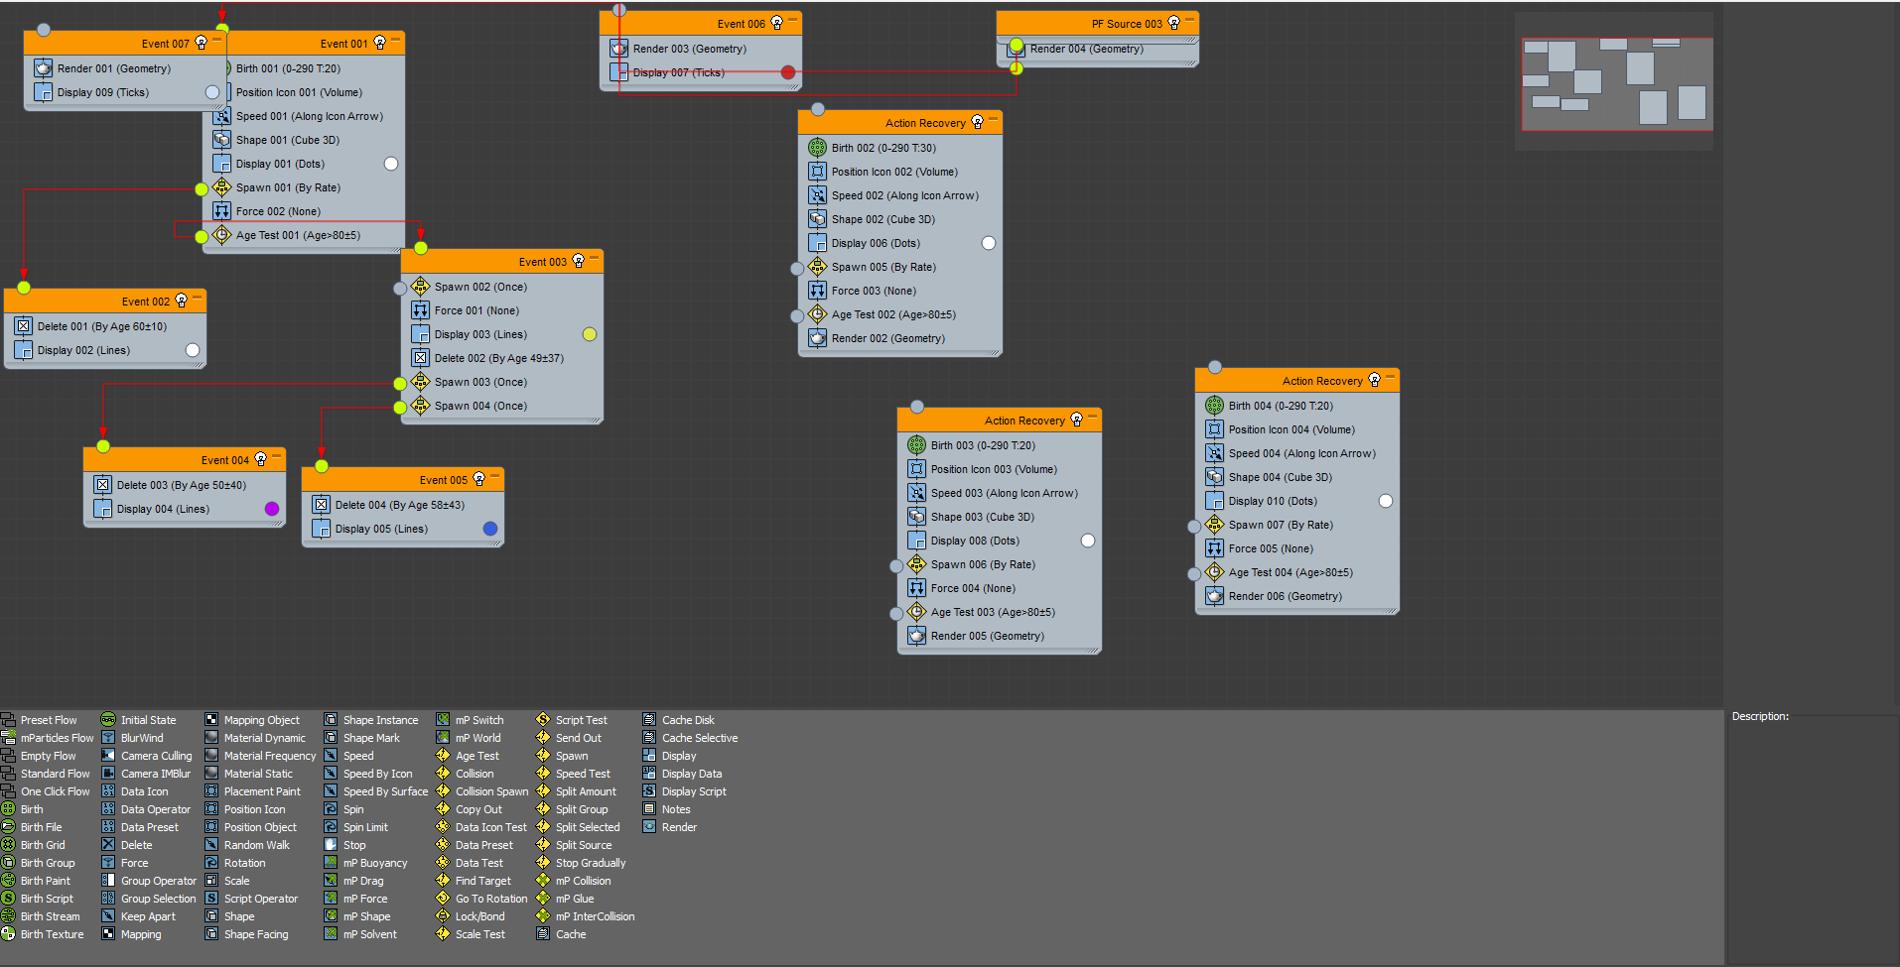
Award
firework
Use the particle view
to construct the scattered
effect

Slide 23
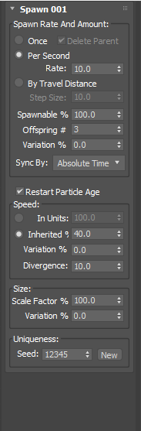
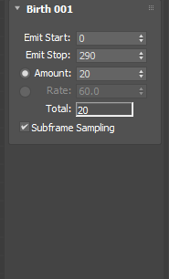
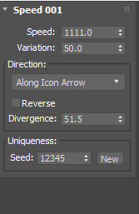
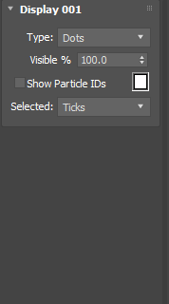
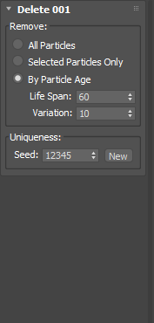
Firework

Slide 24
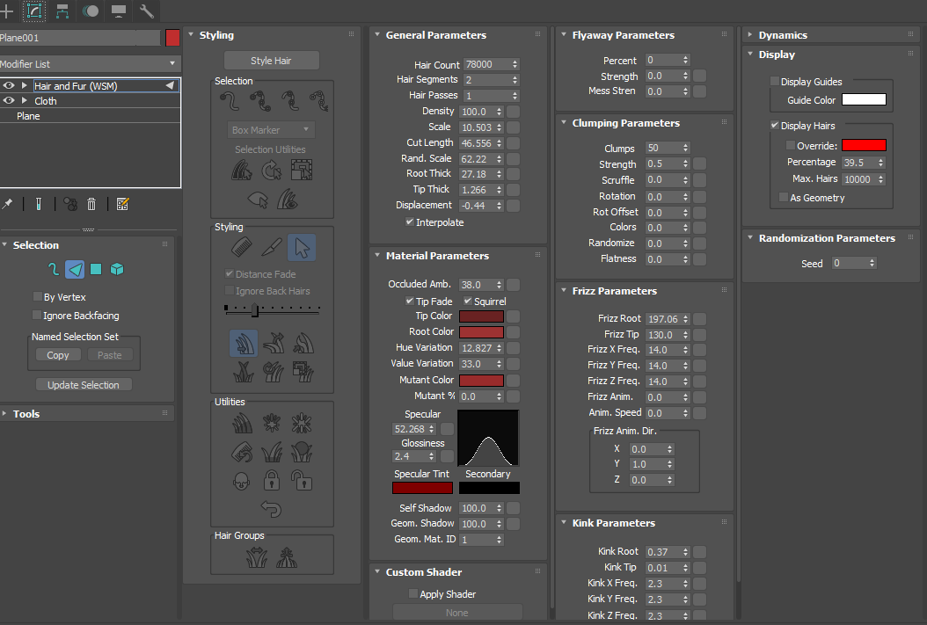
Award
Red Carpet
Apply the modifier
Hair and Fur

Slide 25

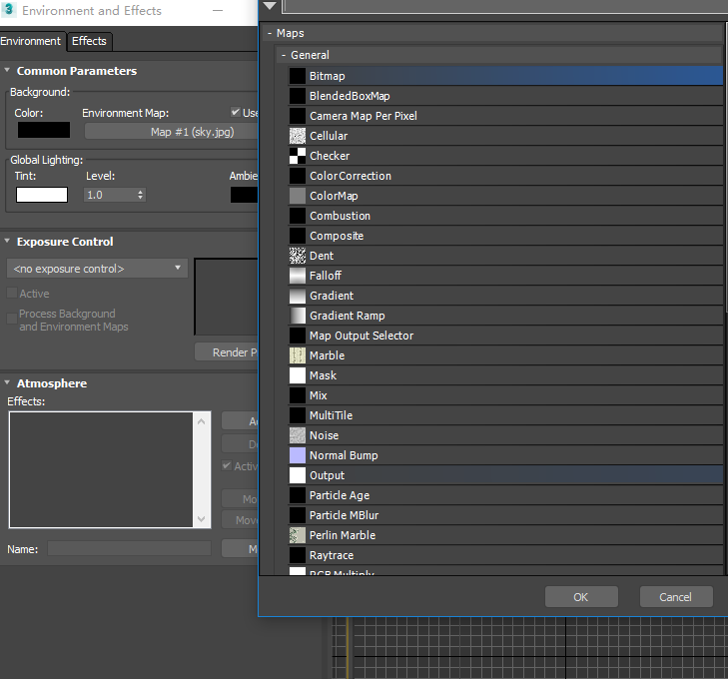
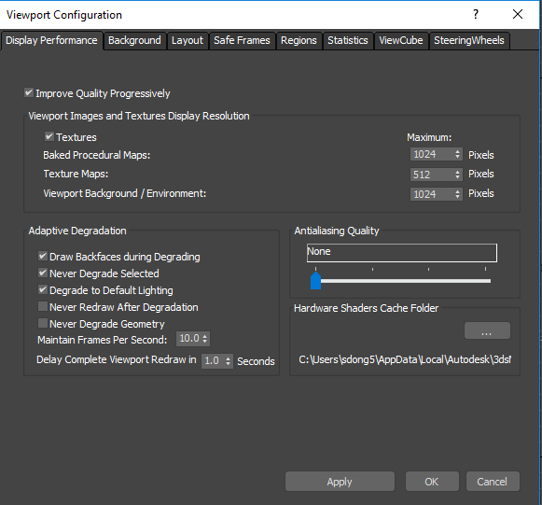
Award
Sky

Slide 26
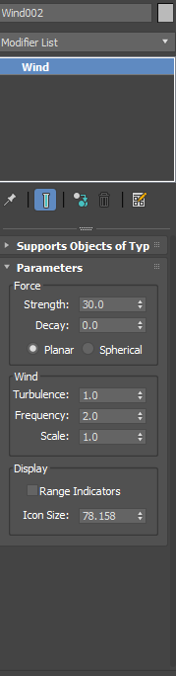
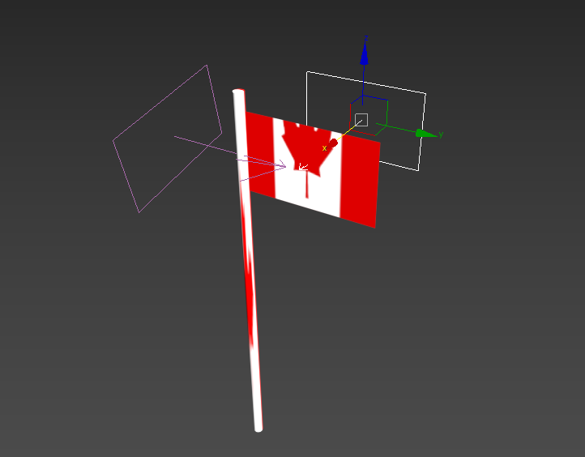
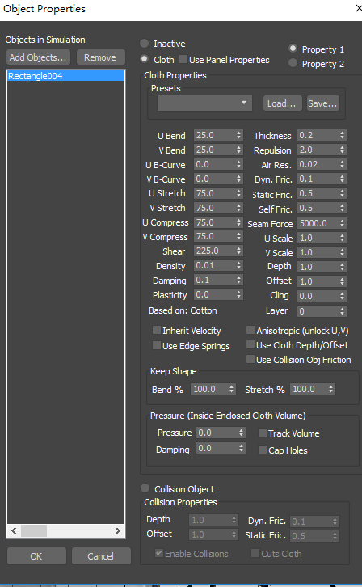

Award
Flag

Slide 27


Award
Crowds

Slide 28

Motion

Slide 29




Motion
Add motion path
to objects.

Slide 30


Motion
Follow V.S Bank

Slide 31

Motion
More Cool Stuff:
Particles
reference:https://gyazo.com/3b2b698f991c2f257e0cead2703753a3

Slide 32


Bones and rigging

Slide 33

Problems with Footstep
Upper body is hard to control
When using the running footstep, the man skips between steps

Slide 34


Curve Editor
Create 1 cycle of animation first
Holding shift and drag the keyframes to the next cycle(copy)
Open curve editor to change the positions(or rotation)

Slide 35


Curve Editor
Change track view to linear
Holding control and drag it to the position in next cycle

Slide 36


Curve Editor
Usually position is controlled by the hip bones
Only need to change 1 position in running on floor
Need to change 2 positions(x-axis or y-axis and z-axis) in running up stairs

Slide 37

Curve Editor
If want to make characters to turn right or turn left while walking need to change both x-axis and y-axis in position plus z-axis in rotation

Slide 38




Motion
Object movement
Action with other objects:
Add the skin modifier
Add Bones (the one you want the object to
move with)
Facial expression
Modifier -> Morpher

Slide 39

Problems
Shadows of character model in the city(Not fixed yet)
Action details
Fluency of video

Slide 40
Software
3ds Max
Final Cut Pro, iMovie
Paint
https://free3d.com/
https://www.mixamo.com/#/
http://www.mayawu.com/
Reference

Slide 41
Any Questions?

